Slide 1
SOS and Theft Alert !!
-Shivani Bhalchandra

Slide 2
IDEA : Safety FIRST!!
Solution towards home safety and security using motion detection sensors of SenseHat.
Motivation
Theft Control
Medical Emergency Alert
When a magnetic field of the safe lock handle is changed in the wrong way it should trigger an alarm.
Also motion detection capability will trigger an SOS alarm via EMAIL in case of emergency

Slide 3
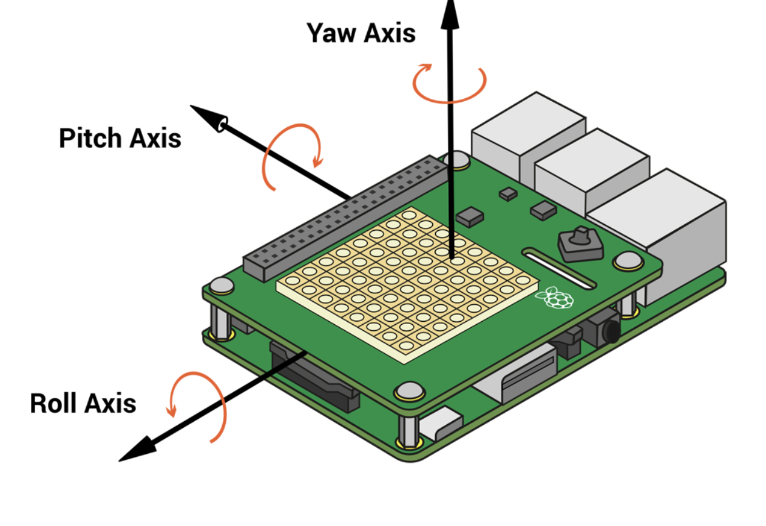
IMU SENSOR -3 in 1
The Sense HAT has a movement sensor which measures the kinds of movement it experiences. IMU stands for Inertial Measurement Unit
Gyroscope: measures momentum and rotation
Accelerometer: measures acceleration forces, can be used to find the direction of gravity
Magnetometer: measures the Earth’s own magnetic field, a bit like a compass

Slide 4
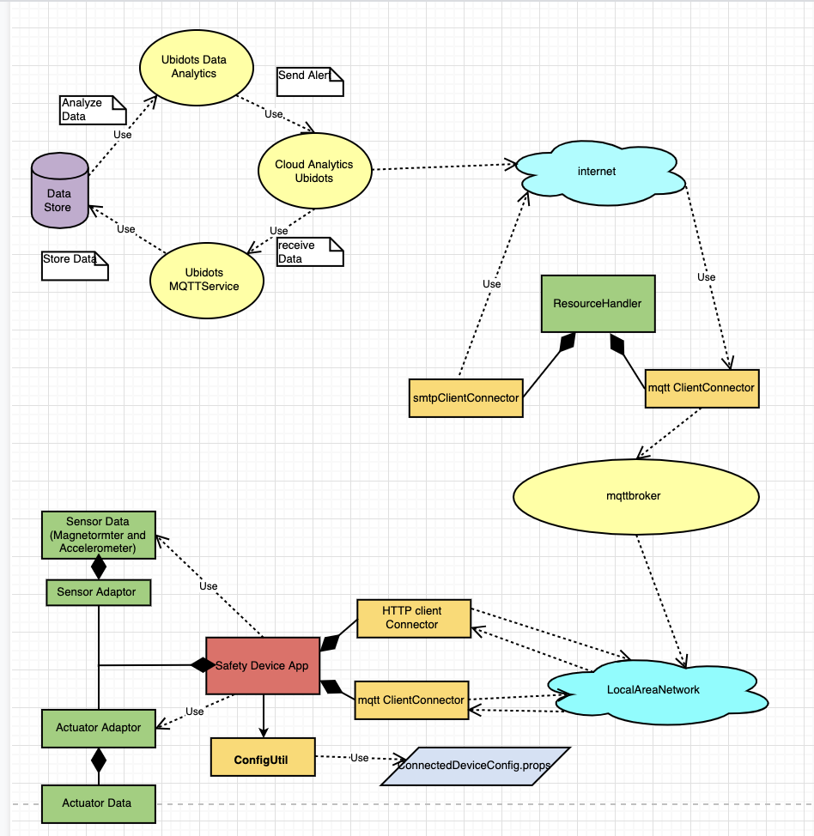
Design

Slide 5
Protocols USED
MQTT
Publishing SOS Alert sensor data
Subscribing to Burglar Alarm alert and SOS Alert
HTTP
Publishing Burglar Alarm Sensor Data
SMTP
Sending email alert when both alerts are triggered

Slide 6
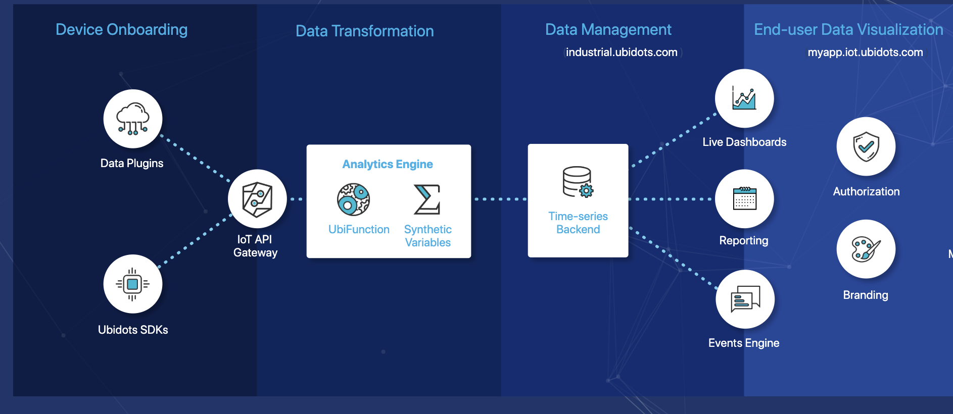
Cloud Service : UBIDOTS

Slide 8
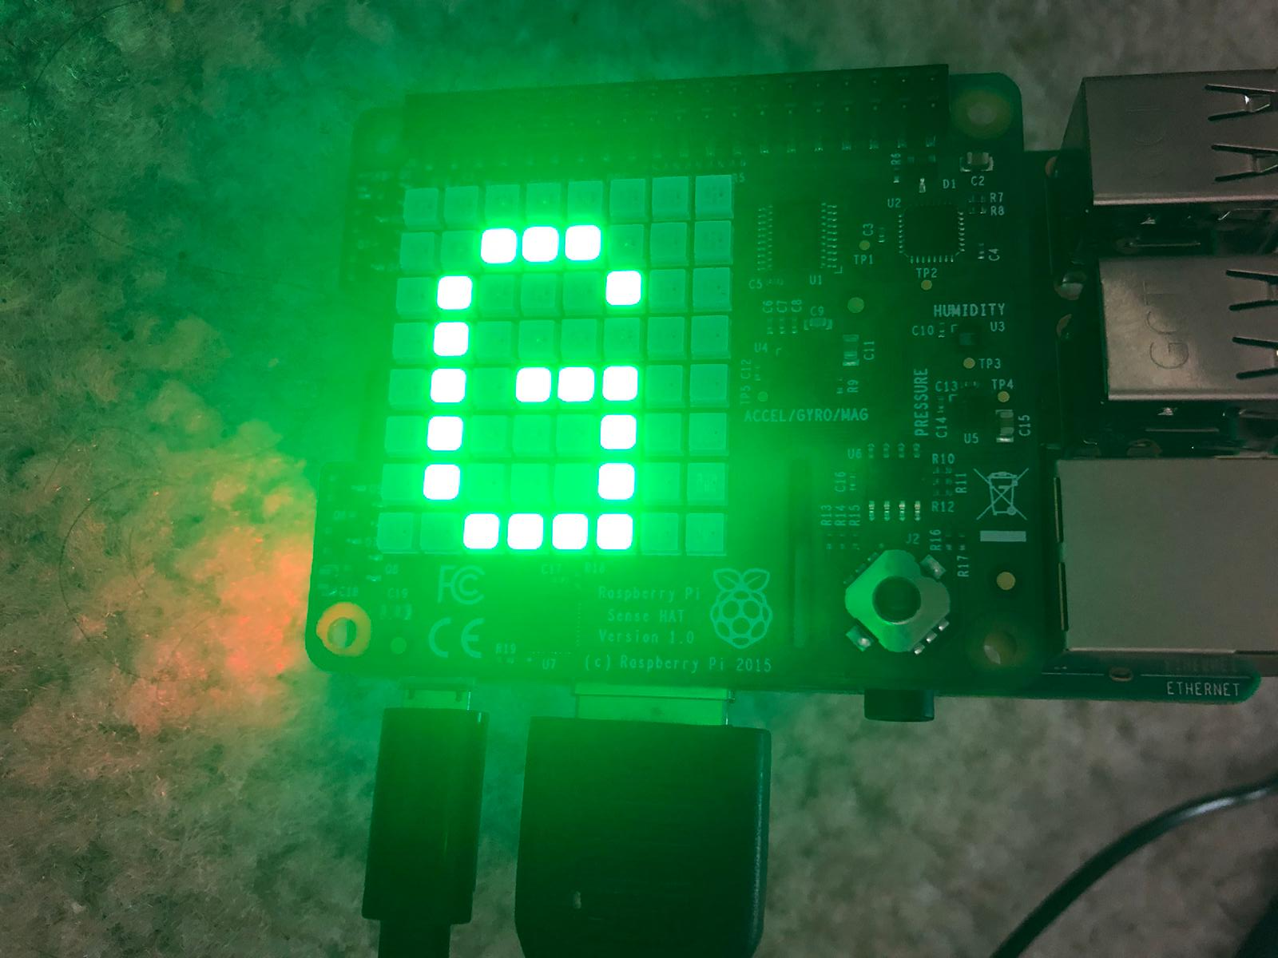
DEMO

Slide 9
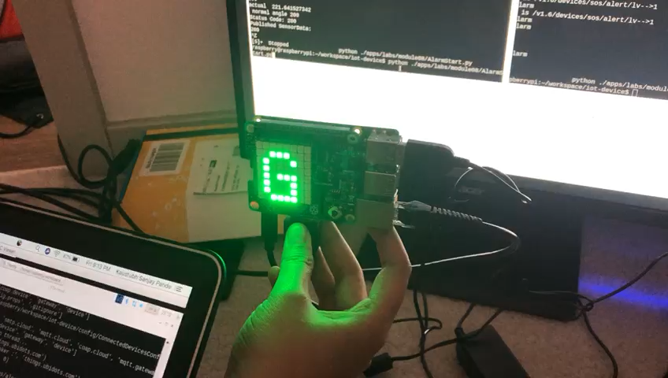
DEMO for ALARM

Slide 10
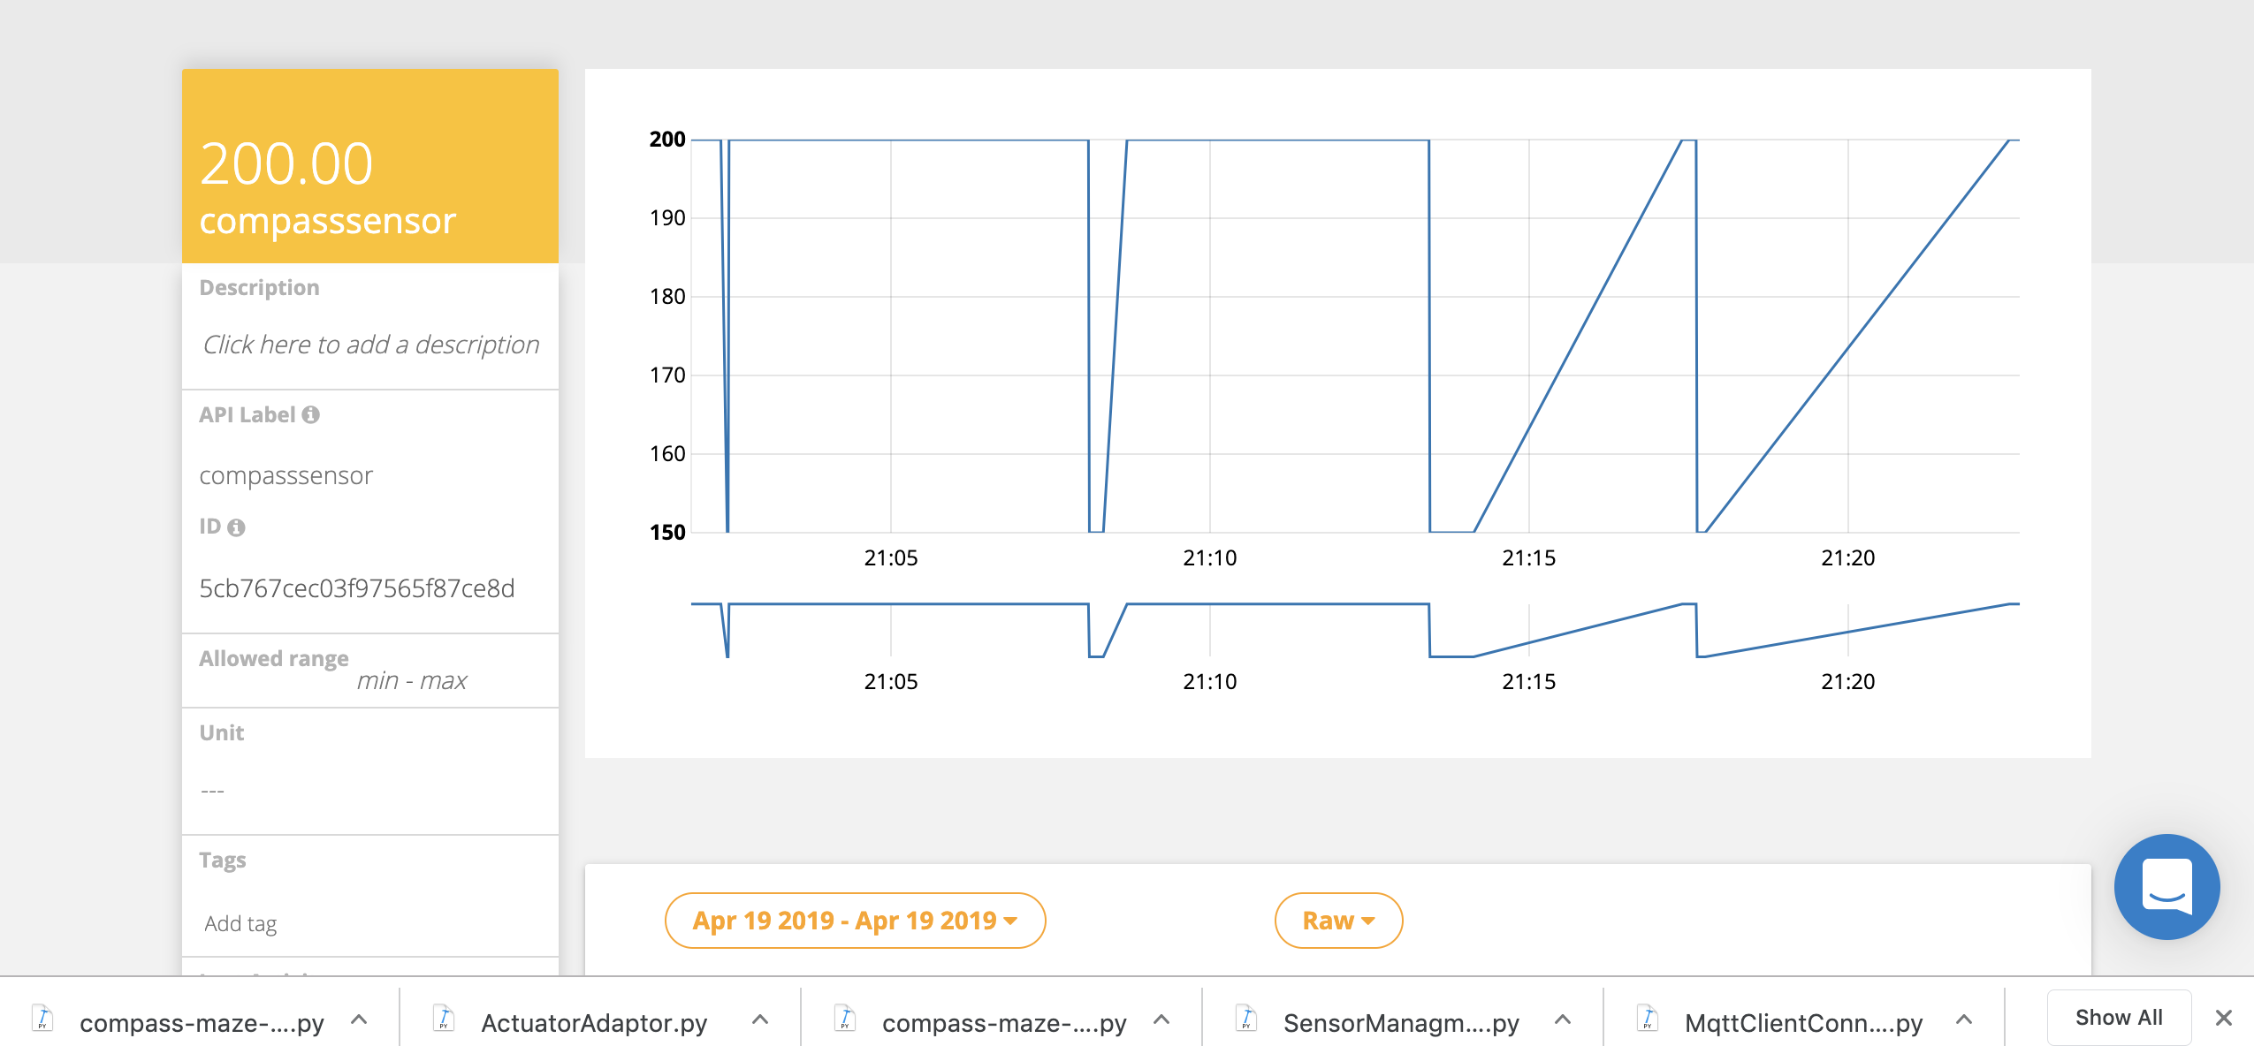

Slide 11
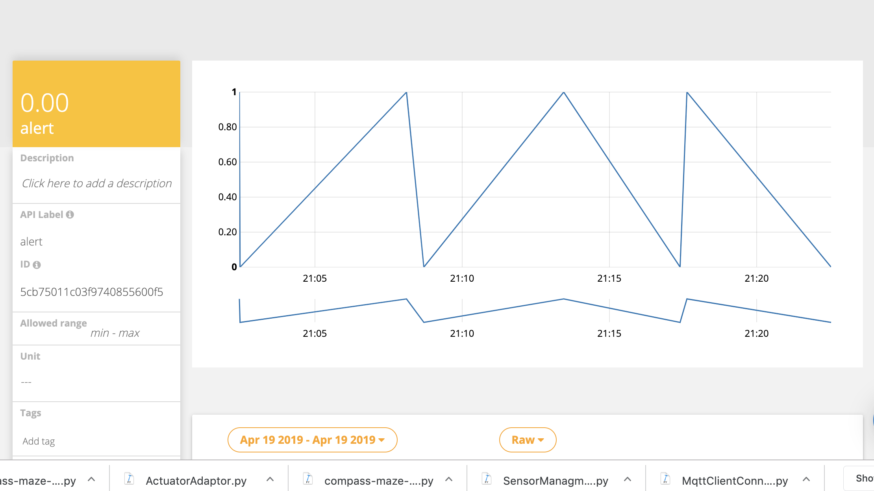

Slide 12
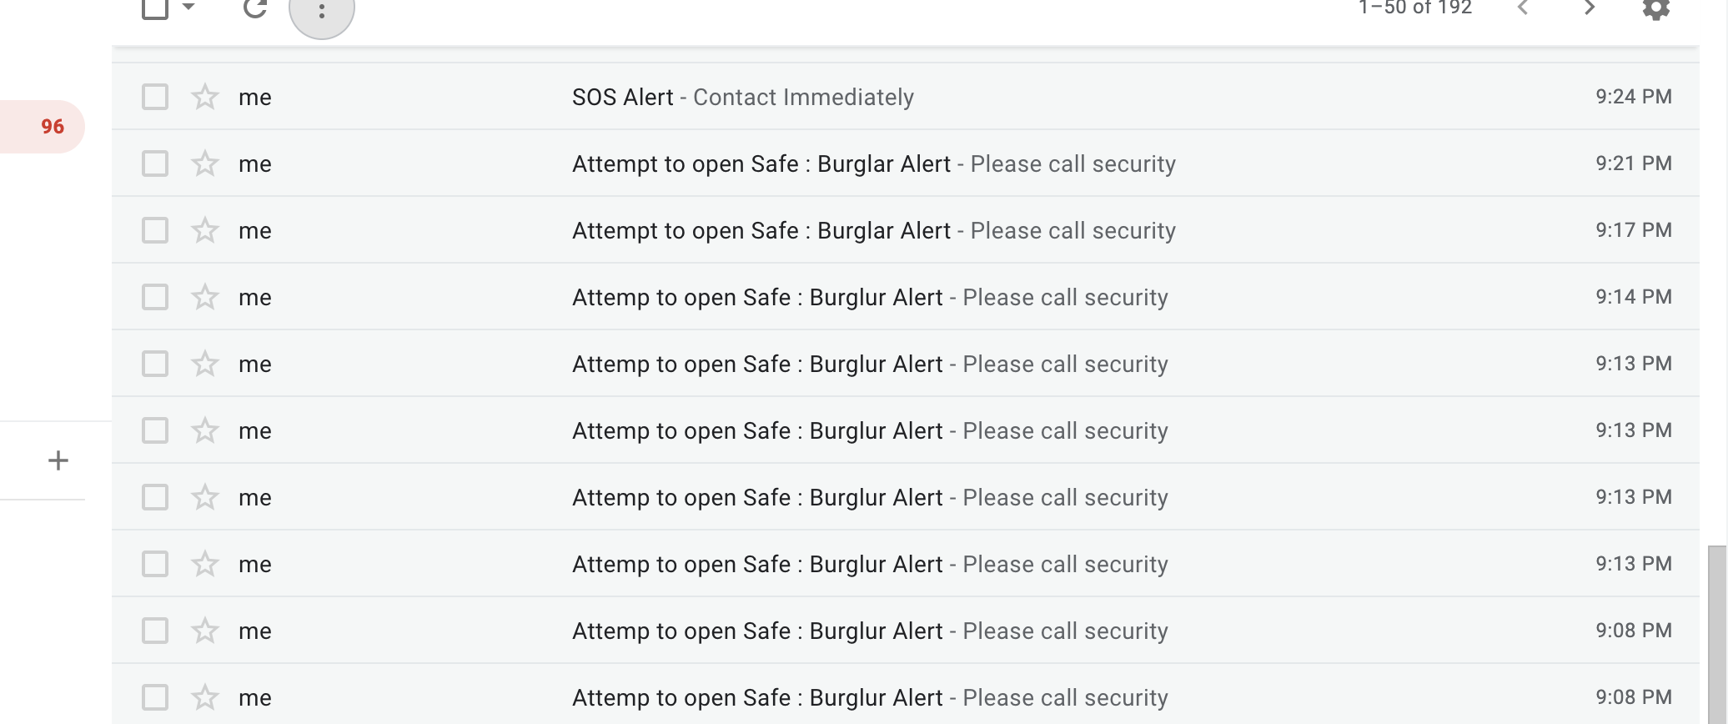

Slide 13
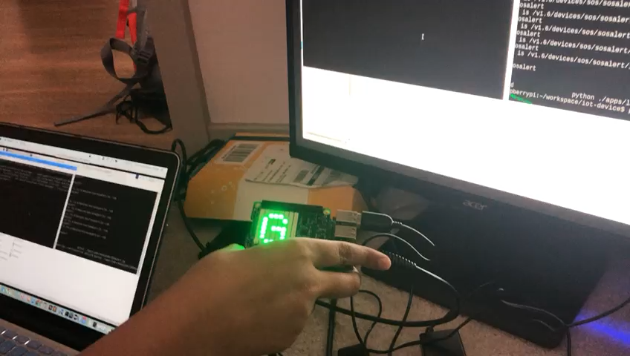
DEMO for SOS ALERT

Slide 14
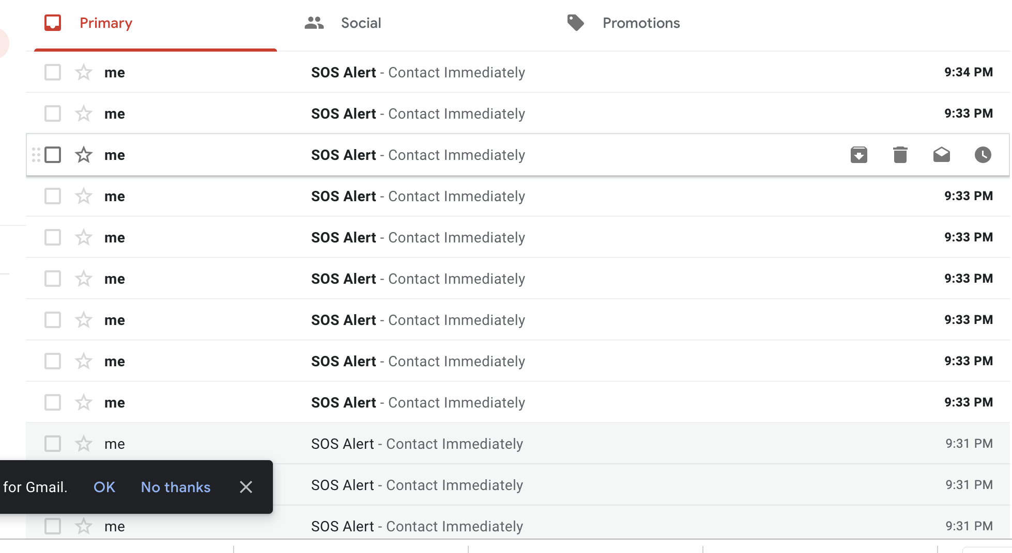

Slide 15
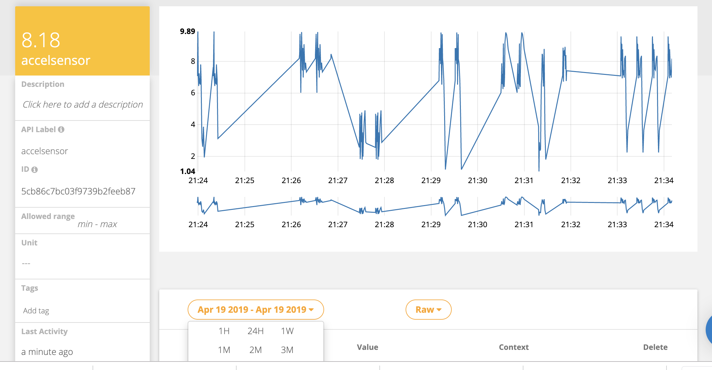

Slide 16
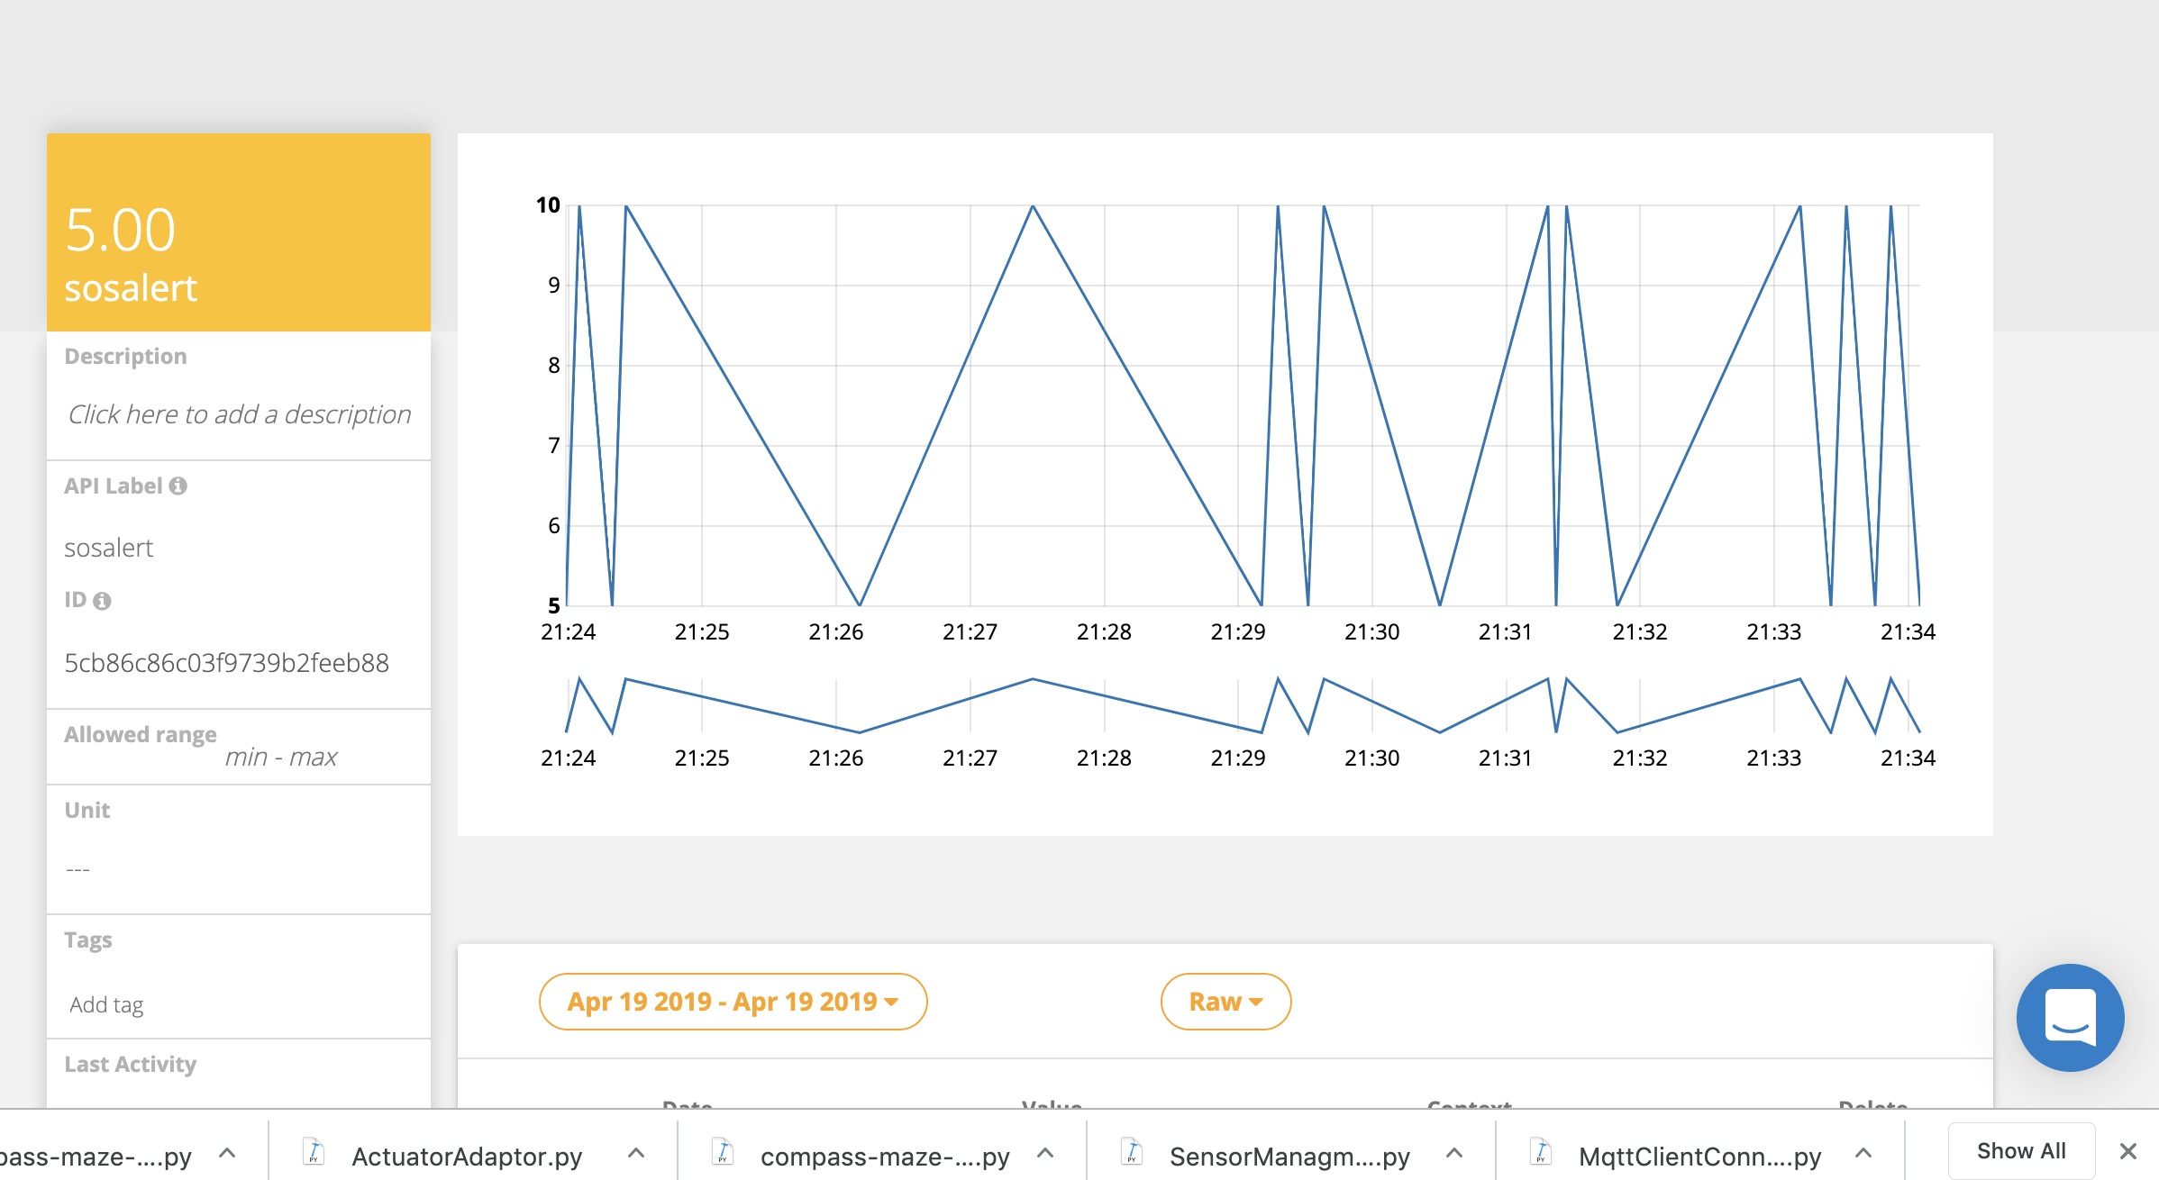

Slide 17
Future Scope
Standalone system
Audio Alert on a Bluetooth speaker when the email arrives.

Slide 18
A full proof anti-burglary and SOS message detection prototype using Raspberry pi and SenseHAT .

Slide 19
Reference:
https://ubidots.com/platform/
https://projects.raspberrypi.org/en/projects/getting-started-with-the-sense-hat/9
https://pythonhosted.org/sense-hat/api/#imu-sensor

